Slide 1
Generating a sequence using a term-to-term rule
Sequences

Slide 2
how to use Oak lessons

Slide 3
I can appreciate that a sequence can be generated and described using term-to-term approaches.

Slide 4
Each value or pattern in a sequence is called a term.
A term-to-term rule describes how to calculate the next term in the sequence from the previous term.

Slide 5

Generating a sequence using a term-to-term rule
Using term-to-term rules
Finding term-to-term rules

Slide 6
Using term-to-term rules
Each value or pattern in a sequence is called a term.
We often refer to individual terms in a sequence.
E.g.
First term, | Second term, | Third term, … | …Tenth term, …
1, | 3, | 5, … | ..., 19, …
For efficiency, you can use notation. In this lesson we will use:
First term
Capital T means we are referencing a specific term.
The number in subscript tell us the term number.
T₁
Second term
T₂
Tenth term
T₁₀

Slide 7
Using term-to-term rules
Sequences can be generated using a rule which tells us how to find the next term.
These are called term-to-term rules.
A term-to-term rule for a sequence is ‘add 5’, what would the next three terms be if your first term is 124?
124, ….
124, 129, 134, 139, …

Slide 8

Using term-to-term rules
How can you find the next 3 terms in each sequence following the term-to-term rule given?
Add −4 to the previous term to get the next term.
+ (−4)
+ (−4)
+ (−4)
6, …
6, 2, −2, -6, …
Multiply the previous term by 5 to get the next term.
× 5
× 5
× 5
(Multiplying by 10 then halving is the same as multiplying by 5)
6, …
6, 30, 150, 750, …
Multiply the previous term by 2 then add 3 to get the next term.
× 2 + 3
6, …
6, 15, 33, 69, …

Slide 9
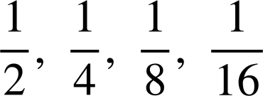
Using term-to-term rules
Which of the sequences below follow the term-to-term rule ‘double the previous term to get the next term’?
1, 2, 4, 8
5, 10, 20, 40
3, 6, 9, 12
−10, −5, 5, 10
term-to-term rule could be ‘add 3’
−80, −20, −10, −5,
11, 22, 33, 44
term-to-term rule could be ‘halve previous term’
term-to-term rule could be ‘add 11’
term-to-term rule could be ‘halve previous term’

Slide 10
Using term-to-term rules
Match the term-to-term rule with the sequence:
Multiply by 4 each time
1, 4, 13, 40, …
Multiply by 3 then add 1 to get the next term
1, 4, 9, 16, …
Add 3, add 5, add 7, add 9,...
1, 4, 10, 22, …
Multiply by 2 then add 2 to get the next term
1, 4, 16, 64, …

Slide 11
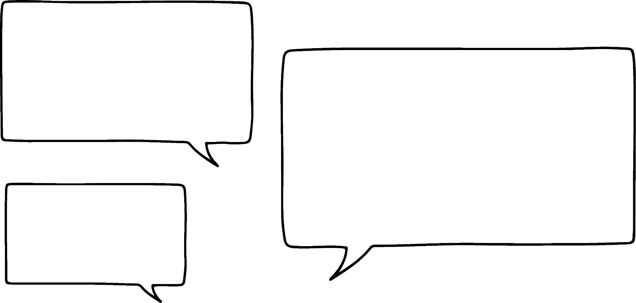




Using term-to-term rules
Andeep’s classmates are trying to guess his sequence.
The term-to-term rule is ‘× 0.1’
500, 50, 5,…
Aisha
Andeep
0.1, 0.01, 0.001,…
Are any of them correct?
Jacob
All these sequences have a term-to-term rule of ‘× 0.1’
82, 8.2, 0.82,…
Without more information there's no way of knowing if they are Andeep’s sequence.
Lucas

Slide 12
Using term-to-term rules
Andeep has added some extra information.
400, 40, 4,…
The term-to-term rule is ‘× 0.1’
My sequence has the number 4 as a term.
Aisha
Andeep
4, 0.4, 0.04,…
Do all of the sequences match the information given?
Jacob
4000, 400, 40,…
They are all correct. Lucas’ sequence will have the number 4 in it if he writes out more terms.
Lucas

Slide 13
Using term-to-term rules
Andeep rephrases his statement.
The term-to-term rule is ‘× 0.1’
T₂ = 4.
Andeep
What are the first 5 terms in his sequence?
÷ 10
(Multiplying by 0.1 is the same as dividing by 10)
× 0.1
× 0.1
× 0.1
× 0.1
40
,
4
,
0.4
,
0.04
,
0.004
, …
(Dividing by 0.1 is the same as multiplying by 10)
× 10
÷ 0.1

Slide 14
Using term-to-term rules
Andeep thinks of a new rule .
What are the first 5 terms in his sequence?
The term-to-term rule is add 3. The third term is 7.
Andeep
+ 3
+ 3
1
,
4
,
7
,
10
,
13
, …
− 3
− 3

Slide 15
Using term-to-term rules
How could we use this rule to find the 10th term in the sequence?
The term-to-term rule is add 3. The third term is 7.
Using a term-to-term rule can be time consuming when looking for larger term numbers.
Andeep
T₁ | T₂ | T₃ | T₄ | T₅ | T₆ | T₇ | T₈ | T₉ | T₁₀
1 | 4 | 7 | 10 | 13
16
19
22
25
28
+ 3
+ 3
+ 3
+ 3
+ 3

Slide 16
Using term-to-term rules
This sequence starts at the number 3 and adds 4 each time.
What is the 10th term?
T₁ | T₂ | T₃ | T₄ | T₅ | T₆ | T₇ | T₈ | T₉ | T₁₀
3
39
+ 4
+ 4
+ 36
Is there a way to make this process quicker?
How many times do we need to add 4 to get from T₁ to T₁₀ ?
We need to add 4 nine times,
4 × 9 = 36
3 + 36 = 39

Slide 17

Using term-to-term rules
My sequence starts at 7 and adds 5 each time. How can I work out T₁₀?
10 × 5 = 50 so you need to add on 50
Aisha
Laura
What is wrong with Aisha’s statement?
9 × 5 = 45 so T₁₀ is 45
There are only nine additions between T₁ and T₁₀
What is wrong with Jacob’s statement?
Jacob
He needs to add this value on to the first term.

Slide 18
Using term-to-term rules
My sequence starts at 7 and adds 5 each time. How can I work out T₁₀?
10 × 5 = 50 so you need to add on 50
Aisha
Laura
9 × 5 = 45 so T₁₀ is 45
Is Lucas now correct?
Jacob
T₁₀ is 7 + 45 = 52
Lucas

Slide 19
Using term-to-term rules
T₁₀ is 7 + 45 = 52
Lucas
T₁ | T₂ | T₃ | T₄ | T₅ | T₆ | T₇ | T₈ | T₉ | T₁₀
7
52
+ 5
+ 45
Yes, adding 5 nine times will give the 10th term of 52.

Slide 20
Using term-to-term rules
Laura thinks of a new sequence
My sequence starts at 3 and doubles each time. To calculate T₁₀ I can do 3 + 9 × 2
What is wrong with Laura’s statement?
Laura
That method only works for sequences with a constant additive rule as repeated addition of a number can be written as multiplication.
Using term-to-term rules to find larger term numbers for more complex sequences can become tricky or time consuming.

Slide 21

Using term-to-term rules
To find the 10th term of any sequence with a constant additive rule, you can multiply the first term by 9
You need to multiply by 10 instead.
You need to know the rule and multiply the value we are adding by 9 then add on to T₁

Slide 22
Using term-to-term rules
This crossnumber is made from sequences written from left to right or from top to bottom. Fill in the crossnumber according to the given rules. Fill in the missing rule for ‘A: down’
A
Across
 | -4
7
B
E
F
B: add (−6) each time
C: add 12 each time
D: add 24 each time
C
Down
A: add each time
E: add 17 each time
D
F: add 29 each time

Slide 23
Using term-to-term rules
2) For each sequence, use the term to term rule to find the desired term.
Start on 2 and add 7 each time. Find the value of T₃
Start on 1 and multiply by 3 each time. Find the value of T₄
Start on 6, double then add 10 each time. Find the value of T₄
Start on 5, add −4 each time. Find the value of T₆
Start on 10, multiply by 2 each time. Find the value of T₈
Start on −4, add 5 each time. Find the value of T₁₀
Start on 24, add −2 each time. Find the value of T₂₅

Slide 24
Using term-to-term rules
This crossnumber is made from sequences written from left to right or from top to bottom. Fill in the crossnumber according to the given rules. Fill in the missing rule for ‘A: down’
A
Across
 | -4
7 | 1 | −5 | −11 | −17 | −23
 | 6 |  | 6 |  | 6
 | 11 |  | 23 |  | 35
4 | 16 | 28 | 40 | 52 | 64 | 76
 | 21 |  |  |  | 93
 | 26 | 50 | 74 | 98 | 122
B
E
F
B: add −6 each time
C: add 12 each time
D: add 24 each time
C
Down
A: add 5 each time
E: add 17 each time
D
F: add 29 each time

Slide 25
Using term-to-term rules
2) For each sequence, use the term to term rule to find the desired term.
Start on 2 and add 7 each time. Find the value of T₃
Start on 1 and multiply by 3 each time. Find the value of T₄
Start on 6, double then add 10 each time. Find the value of T₄
Start on 5, add −4 each time. Find the value of T₆
Start on 10, multiply by 2 each time. Find the value of T₇
Start on −4, add 5 each time. Find the value of T₁₀
Start on 24, add −2 each time. Find the value of T₂₅
16
27
118
-15
640
41
-24

Slide 26
Generating a sequence using a term-to-term rule
Using term-to-term rules
Finding term-to-term rules

Slide 27
Finding term-to-term rules
If you know a sequence has a constant additive pattern then you can find a term-to-term rule even when you have missing terms.
This sequence has a constant additive pattern. How could we find a term-to-term rule?
1
,
,
17
,
,
33
, …

Slide 28
Finding term-to-term rules
+ 8
+ 8
+ ?
1
,
,
17
,
,
33
, …
+ 16
We need to work out what value is added to T₁ to get T₂
Start by finding the difference between terms we do know.
T₃ − T₁ 17 − 1 = 16
Now consider how many times our value has been added to T₁ to get T₃
So 16 ÷ 2 will tell us what each addition is.
A term-to-term rule could be ‘plus 8’

Slide 29
Finding term-to-term rules
1
,
9
,
17
,
25
,
33
, …
+ 8
+ 8
+ 8
+ 8
Check this works by filling in some terms.

Slide 30
Finding term-to-term rules
+ 9
+ 9
+ 9
+ 9
23
,
32
,
41
,
50
,
59
, …
+ 36
How about when we have more missing terms?
T₅ − T₁ 59 − 23 = 36
How many times has our value been added to T₁ to get T₅ ?
So 36 ÷ 4 will tell us what each addition is
A term-to-term rule could be ‘plus 9’

Slide 31
Finding term-to-term rules
Find a term-to-term rule for a constant additive sequence with T₂= 7 and T₅= 19
Find a term-to-term rule for a constant additive sequence with T₁= 2 and T₆= 42
T₁ , 7 , T₃ , T₄ , 19
2 , T₂ , T₃ , T₄ , T₅ , 42
+ 12
+ 40
19 − 7 = 12
42 − 2 = 40
12 ÷ 3 = 4
40 ÷ 5 = 8
The term-to-term rule is ‘+ 4’
The term-to-term rule is ‘+ 8’

Slide 32

Finding term-to-term rules
What could the term-to-term rule be for this sequence?
3, 12, 48, 192 ….
Multiply the previous term by 4 to get the next term
How can we write a term-to-term rule for this sequence?
−96, 48, -24, 12, −6, ….
Multiply the previous term by to get the next term

Slide 33

Finding term-to-term rules
1
2
The first number in my sequence is 1
Is this enough information to work out the term-to-term rule for Alex’ sequence?
No, Alex’ sequence can have any rule.
Alex
The second number in my sequence is 2
Is this enough information to work out the term-to-term rule for Alex’ sequence?
No.
What rules can you think of that will work?
E.g. ‘Add 1’ ‘Multiply by 2’ ‘Multiply by 5 then subtract 3’ …

Slide 34
Finding term-to-term rules
My sequence starts 1, 2, 4, …
There is only one sequence it can be now.
1
2
4
Alex
Is Alex correct?
No. Even though there are now fewer rules that work, there are still more than 1.
What rules can you think of that will work?
E.g. ‘Multiply by 2’ ‘Add 1, then 2, then 3,...’
Often when we are given 3 terms we will be able to describe a term-to-term rule.
However it is possible that other rules also work.

Slide 35
Finding term-to-term rules
Which term-to-term rule could describe the sequence which starts: 2, 6, …
Multiply the previous term by 3 to get the next term
Multiply the previous term by 6 to get the next term
Add −4 to the previous term to get the next term
Add 4 to the previous term to get the next term

Slide 36
Finding term-to-term rules
Which term-to-term rule could describe the sequence which starts: 3, 5, …
Add 2 to the previous term to get the next term
Multiply the previous term by 2 to get the next term
Multiply the previous term by 2 then subtract 1 to get the next term
Subtract 2 from the previous term then multiply by 5 to get the next term

Slide 37
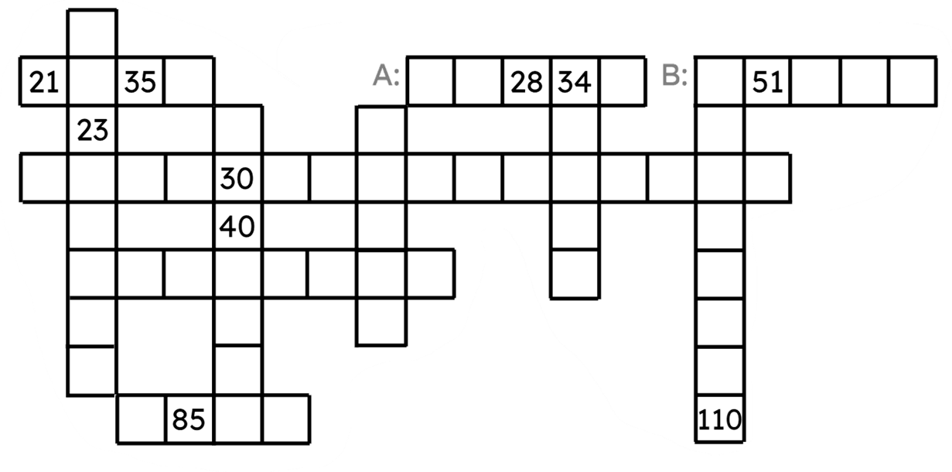
Finding term-to-term rules
Fill in each row and column so they form a sequence with a constant additive pattern. Then fill in the term-to-term rules for the stated rows.
A term-to-term rule for row A is .
A term-to-term rule for row B is .

Slide 38
Finding term-to-term rules
Fill in each row and column so they form a sequence with a constant additive pattern. Then fill in the term-to-term rules for the stated rows.
21 |  | 35
 | 23
 |  |  |  | 30
 |  |  |  | 40
 |  |  | 85
28 | 34 |  |  |  | 51
 |  |  |  | 110
A:
B:
A term-to-term rule for row A is .
A term-to-term rule for row B is .

Slide 39
Finding term-to-term rules
2) Describe a term-to-term rule for each sequence below
4, 7, 10, …
13, 26, 52, …
0.2, 2, 20, …
5, −3, −11, …
7, -21, 63, …
2, 5, 11, …
3) Alex and Aisha are writing term-to-term rules for a sequence with T₁= 5 and T₂= 15
Me and Aisha have different rules so one of us must be wrong
Explain why Alex is incorrect.
What rules could they have written?
Alex

Slide 40
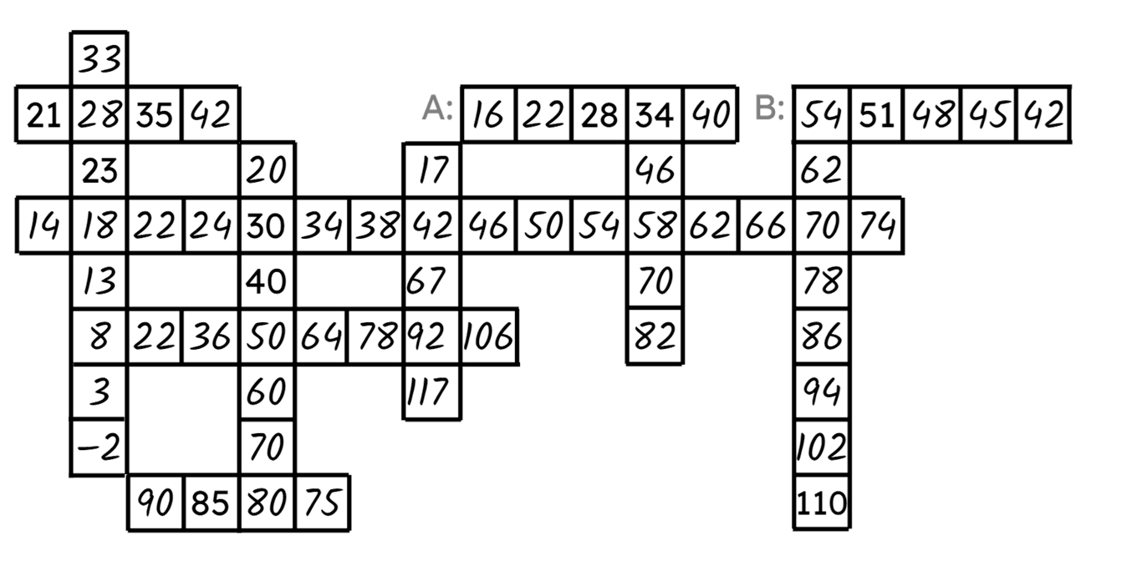
Finding term-to-term rules
Fill in each row and column so they form a sequence with an additive pattern. Then fill in the term-to-term rules for the stated rows.
A term-to-term rule for row A is ‘Add 6’.
A term-to-term rule for row B is ‘Add −3’ or ‘Minus 3’.

Slide 41
Finding term-to-term rules
Fill in each row and column so they form a sequence with an additive pattern. Then fill in the term-to-term rules for the stated rows.
 | 33
21 | 28 | 35 | 42 |  |  |  |  | 16 | 22
 | 23 |  |  | 20 |  |  | 17
14 | 18 | 22 | 24 | 30 | 34 | 38 | 42 | 46 | 50
 | 13 |  |  | 40 |  |  | 67
 | 8 | 22 | 36 | 50 | 64 | 78 | 92 | 106
 | 3 |  |  | 60 |  |  | 117
 | −2 |  |  | 70
 |  | 90 | 85 | 80 | 75
28 | 34 | 40 |  | 54 | 51 | 48 | 45 | 42
 | 46 |  |  | 62
54 | 58 | 62 | 66 | 70 | 74
 | 70 |  |  | 78
 | 82 |  |  | 86
 |  |  |  | 94
 |  |  |  | 102
 |  |  |  | 110
A:
B:
A term-to-term rule for row A is ‘Add 6’.
A term-to-term rule for row B is ‘Add −3’ or ‘Minus 3’.

Slide 42
Finding term-to-term rules
2) Describe a term-to-term rule for each sequence below
4, 7, 10, …
13, 26, 52, …
0.2, 2, 20, …
5, −3, −11, …
7, -21, 63, …
2, 5, 11, …
E.g. ‘add 3’
E.g. ‘add −8’
E.g. ‘multiply by 2’
E.g. ‘multiply by −3’
E.g. ‘multiply by 10’
E.g. ‘multiply by 2 then add 1’
or ‘add 3, add 6, add 9, …’

Slide 43
Finding term-to-term rules
3) Alex and Aisha are writing term-to-term rules for a sequence with T₁= 5 and T₂= 15
Explain why Alex is incorrect.
What rules could they have written?
Aisha and I have different rules so one of us must be wrong.
It is possible that multiple rules can apply to the same two terms.
Alex
E.g. ‘add 10’, ‘Multiply by 3’, ‘Multiply by 2 then add 5’
‘Add 10, then 20, then 30, …

Slide 44
Generating a sequence using a term to term rule
A term-to-term rule tells us how to generate the next term based on the previous term.
Sequences can be generated from a term-to-term rule.
Using a term-to-term rule to find higher term numbers in a sequence can be time consuming.
It is possible to describe a sequence using a term-to-term rule. This rule may not be unique.

Slide 45

© Oak National Academy 2023.
Produced in partnership with Mathematics in Education and Industry.
Licensed on the Open Government Licence v3.0, except where otherwise stated. See Oak terms and conditions.

